Slide 1
Power Testing on Linear Generator
Power testing on original linear generator from Gaian and new linear generator made by SVV
Conclusion
1. So far new generator has around 10mW output per coil,and original generator output is around 2mW, that means total 6 coils on 2 tubes would be around 60mW/12mW.
2. There are still spare space for more turns or bigger tube/magnets for more output power and more weight as well.
3. In order to charge 250mAh/3.7V(925mWh) Li-ion battery in an hour, output power should be around 1085mW(85% efficiency).

Slide 2
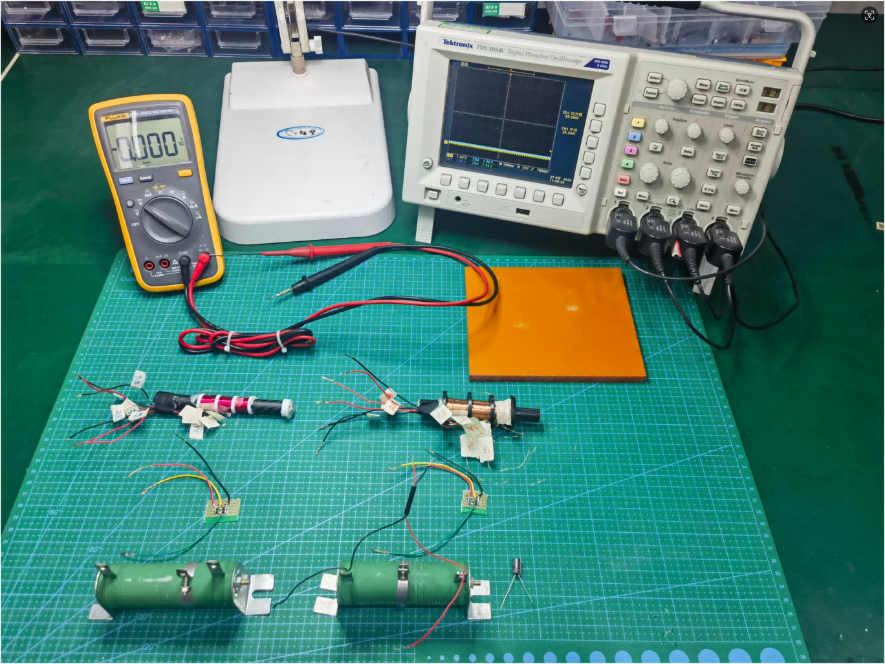
Setting up
Tray Plate
New Linear Generator (0.17mm wire,1350 turns , 60 Ω per coil)
Linear Generator from Gaian
Rectifier Bridge
Load Resistor
680uF Capacitor

Slide 3
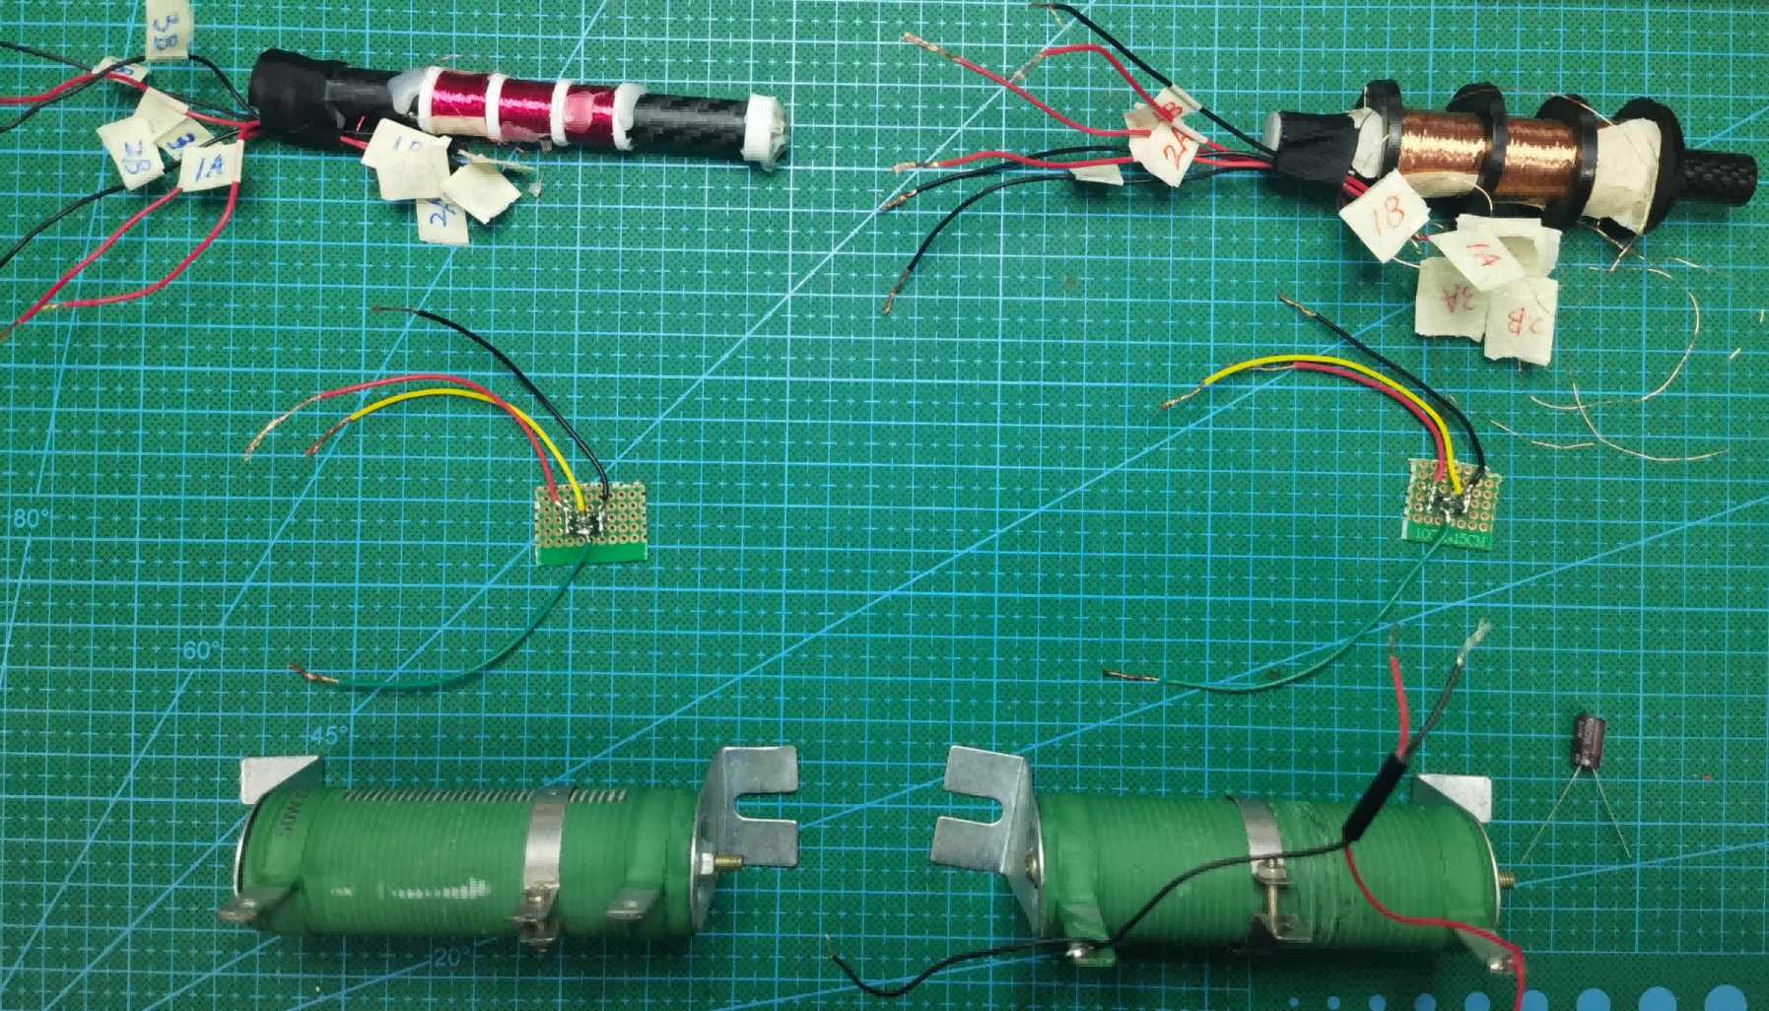
Assembly
2B representing the end of the middle coil
4 Ultra low forward voltage drop diodes, using the same model as PCB designning
Use the middle coil for testing, connecting 2A and 2B to the rectifier bridge

Slide 4
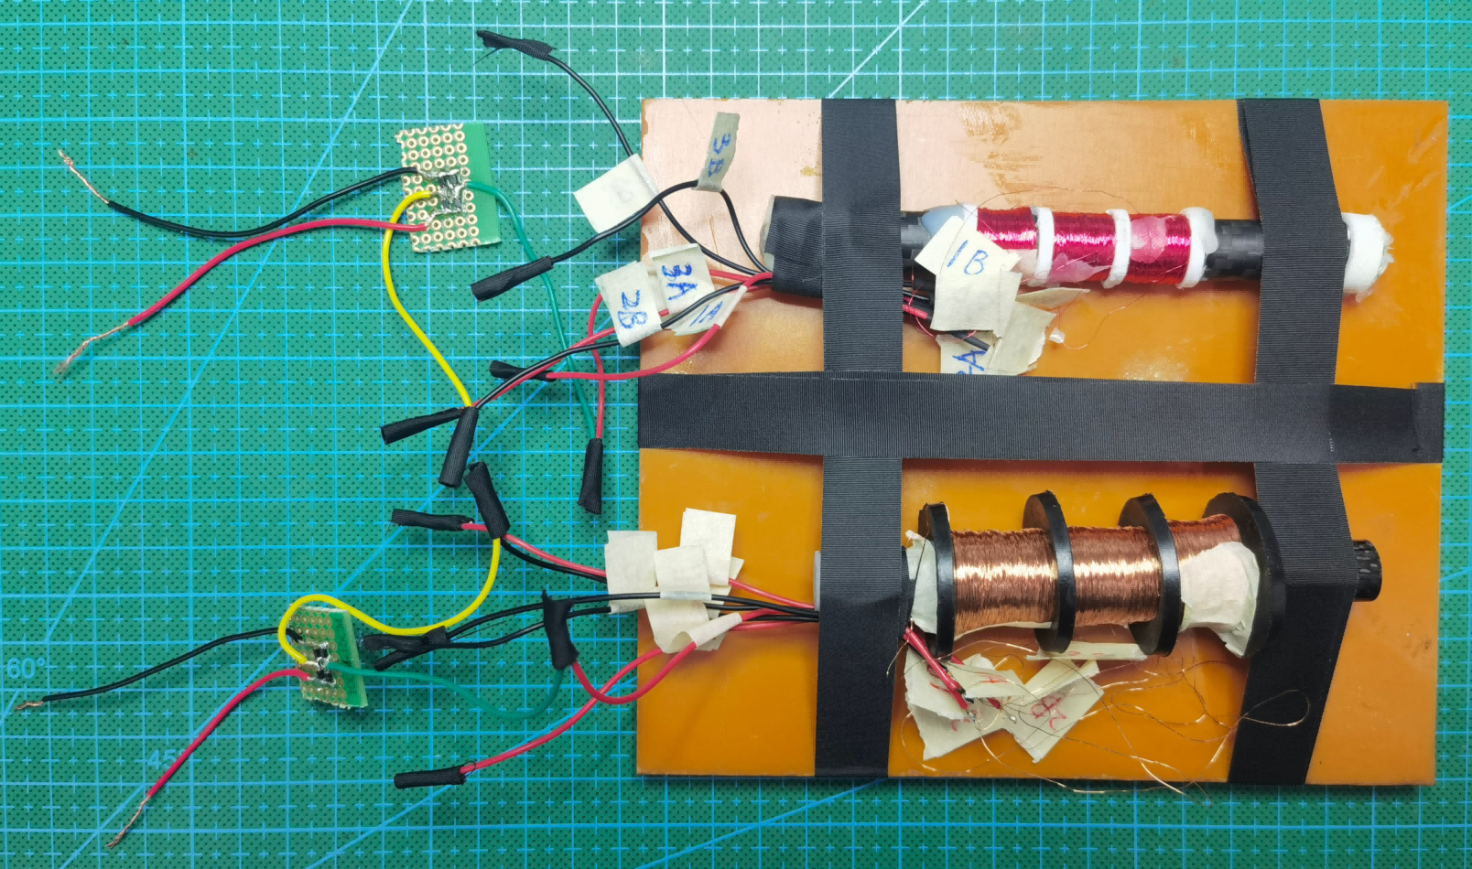
Assembly
Both Generators fixed on the tray plate for synchronized movement

Slide 5
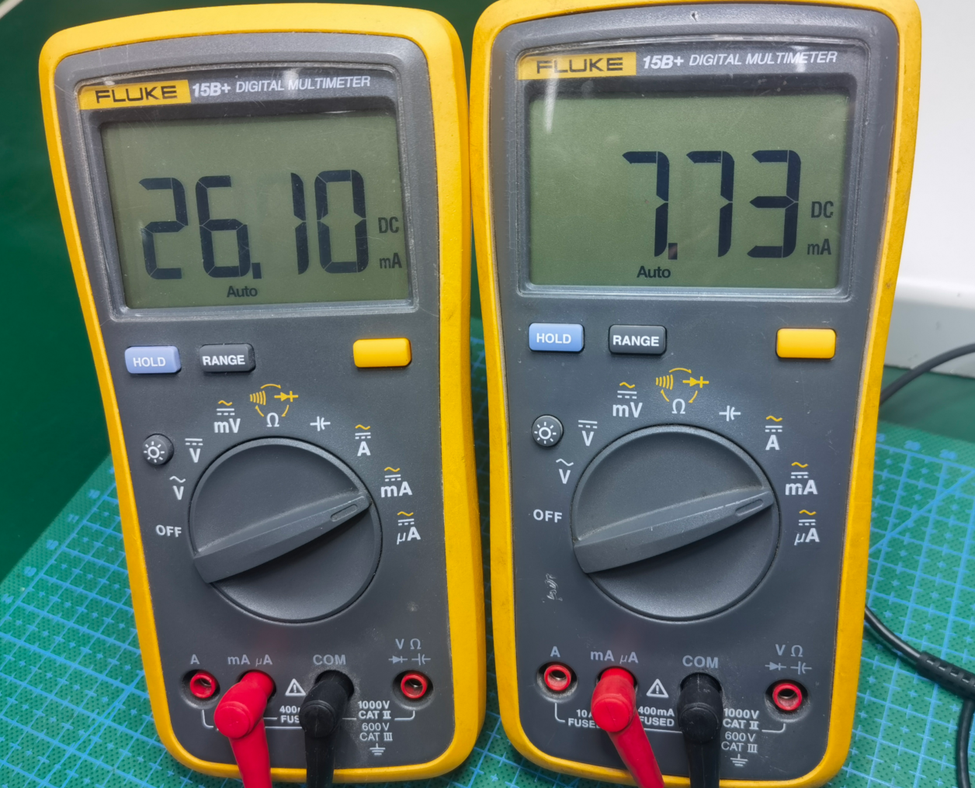
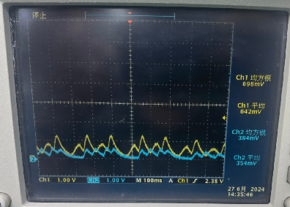
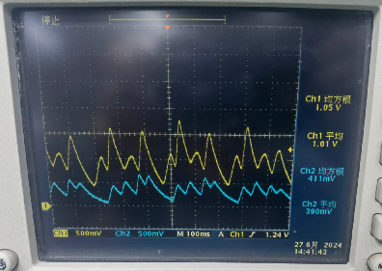
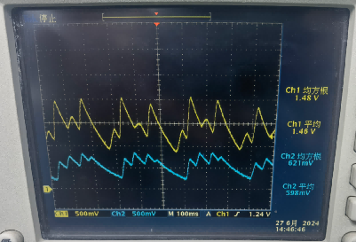
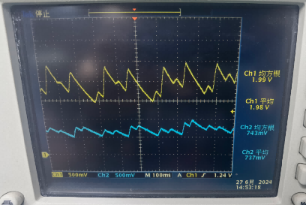
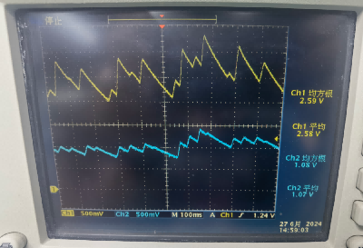
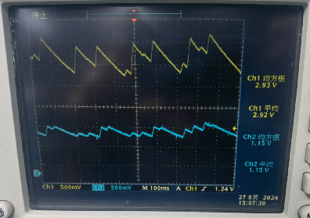
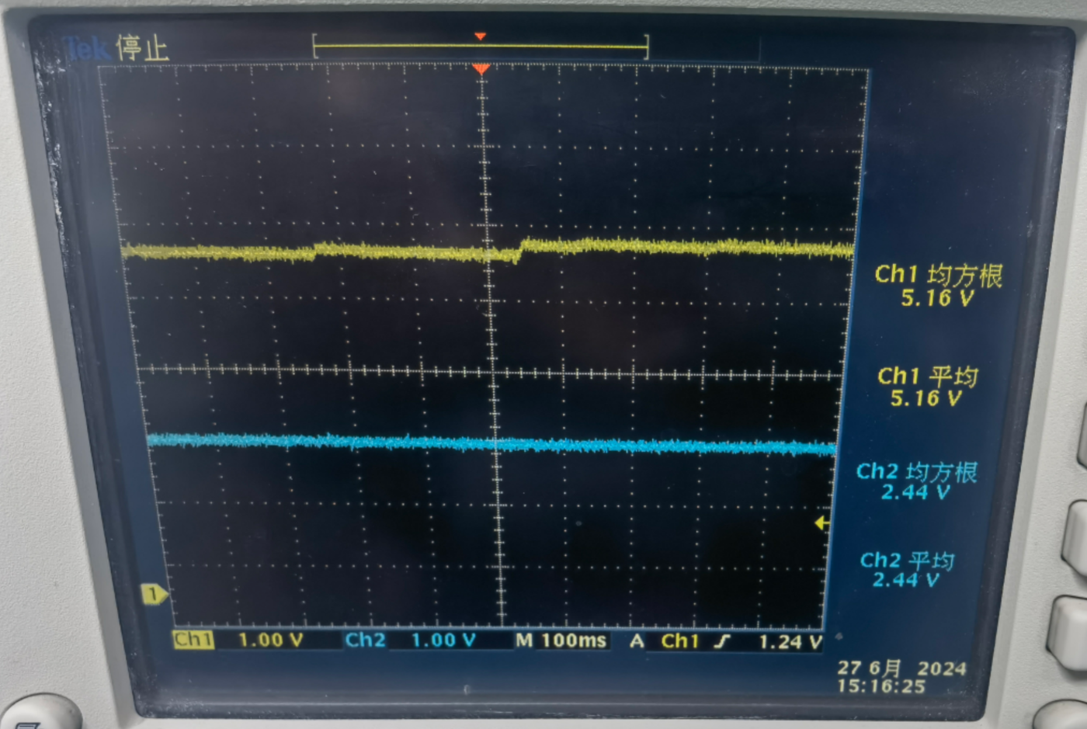
Power Testing
Load=Short(0 Ω)
Load=50 Ω
Load=100 Ω
Load=200 Ω
Load=400 Ω
Load=600 Ω
Load=800 Ω
Load=Open(∞ Ω)
Channel 1(Yellow waveform)：New Linear Generator
Channel 2(Blue waveform)：Linear Generator from Gaian

Slide 6
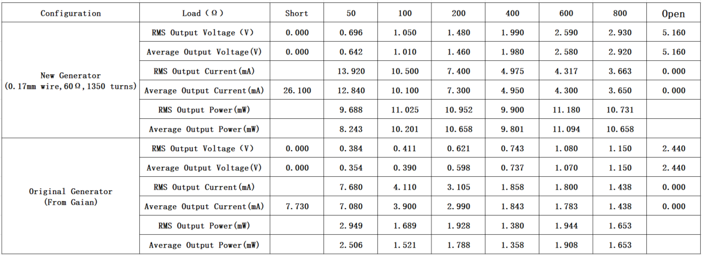
Power Testing

Slide 7
Conclusion
1. So far new generator has around 10mW output per coil,and original generator output is around 2mW, that means total 6 coils on 2 tubes would be around 60mW/12mW.
2. There are still spare space for more turns or bigger tube/magnets for more output power and more weight as well.
3. In order to charge 250mAh/3.7V(925mWh) Li-ion battery in an hour, output power should be around 1085mW(85% efficiency).
Notes:
1. During testing, tray plate are moved by hand back and forth, not totally same as foot movement, but can be an reference.
2. Magnets arrangment in two generators are same, i.e. NS-NS-NS array, we don’t make NS-SN-NS array.
3. When combine more tubes and coils together, there will be little power lose instead of simplly summed up.
4. I don’t think three phases start or triangle connection of coils is good idea because of out-of-phase difference as I mentioned in email.
5. SVV can design PCB board with 6 independent recitifier bridges, Gaian can easily configure connection of 6 bridges to fit their new generator tube and test before sealed in shoes.

